Slide 1
ATLAS Final Presentation:
Student Money Management Center - Data Mining Team
Wednesday, December 4th, 2019

Slide 2
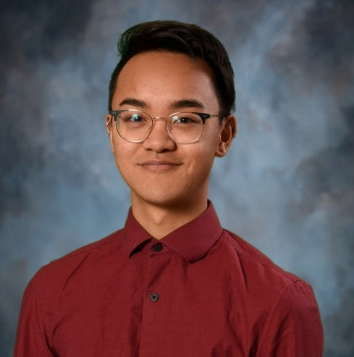
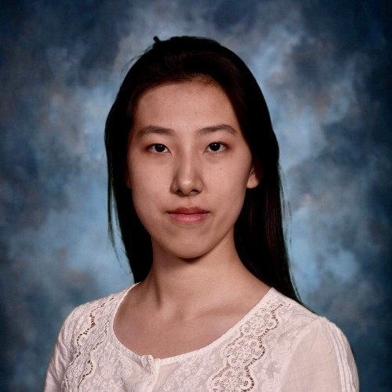
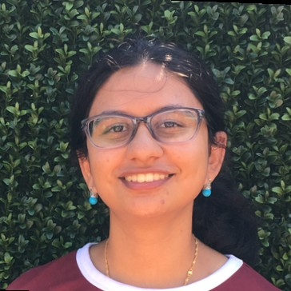
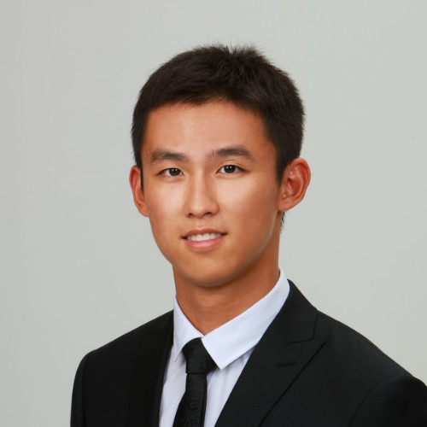
The SMMC Data Mining Team
Smruthi Iyengar
Senior
Economics+
Statistics
Hanqing Wang
Senior
Actuarial Sci & Stats
Kagen Quiballo
Senior
Math + Stats + Informatics
Yuxin Wang
Sophomore
Pre-engineering

Slide 3





The Student Success Initiative @ UIC
SSI
A large-scale project at University of Illinois at Chicago that has been going for several years
This year they are focusing on finances as a means to improve retention and matriculation for undergraduate UIC students
STUDENT SUCCESS INITIATIVE
UNIVERSITY OF ILLINOIS AT CHICAGO
UNIVERSITY STUDENT FINANCIAL SERVICES AND CASHIER OPERATIONS (USFSCO)
STUDENT MONEY MANAGEMENT CENTER
DATA MINING TEAM (INTERNS)
Notes:
The Student Money Management Center (SMMC), a division of USFSCO, empowers University of Illinois’ students to make positive behavioral changes associated with their finances. Through a multi-faceted approach that integrates comprehensive online and in person platforms, they ensure students take control over their financial futures.

Slide 4
Presentation Overview
SECTION I.
Getting Personal
personal goals
personal objectives
what we learned
SECTION II.
The Project
outcomes + conclusions
key takeaways
lessons learned
SECTION III.
Future Directions
suggestions for
next steps
new directions

Slide 5
SECTION I.
Getting Personal
personal goals, objectives, and takeaways

Slide 6
Smruthi
GOALS + OBJECTIVES
Learn how to clean real data
Improve communication, working with others and presenting data
Improve data analysis skills by using machine learning methods
TAKEAWAYS
Learned how to work with others on a team
Learned more about financial literacy.
Realized that not all data is as clean as the data used in classes.

Slide 7
Kagen
GOALS + OBJECTIVES
improve data analytics skills in a real world situation
improve presentation skills
improve teamwork and communication skills
TAKEAWAYS
worked with real-world (messy) data using
SQL, SAS, R, Excel
created 12 presentation deliverables using Tableau visualizations
took initiative with project in allocating tasks

Slide 8
HANQING
GOALS + OBJECTIVES
Improve the coding skills, to be more proficient with R
Improve presentation skills to be able to deliver more fluent presentation
Improve communication skills
TAKEAWAYS
Delivered excessive amount of presentations
Become more proficient with basic coding for data manipulation and visualization
Become more proficient with presenting technical stuff in a transparent way

Slide 9
Yuxin
GOALS + OBJECTIVES
improve technical skills and apply them into the real world
improve teamwork and communication skills
improve the ability of finding resources to use
TAKEAWAYS
worked with real-world data using SQL, R, Excel
listened to clients' feedback and actively gave response
Learned how to assign tasks appropriately and share findings effectively.

Slide 10
SECTION II.
The Project
outcomes, key takeaways, lessons learned

Slide 11
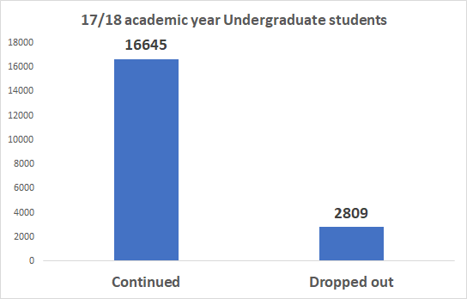
The Target Population
19,454 students identified
Undergraduate students at UIC enrolled between Fall 2017 and Spring 2019

Slide 12
Demographics
Gender: M 49.2% F 50.8%
Residency: Resident 92.7% International 4.3% Non-Resident 3.0%
Year in School: Fr 26.1% So 19.1% Jr 24.0% Sr 30.8%
College: LAS 50.3% Engineering 16.1% Business 13.5%

Slide 13
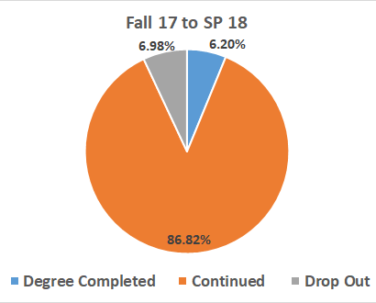
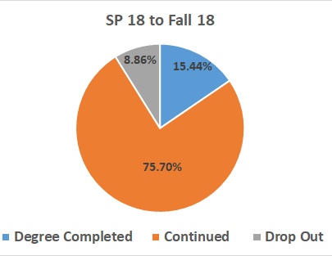
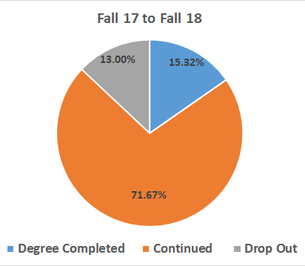
Drop-out Rates
Drop-out
Drop-out + Continued
 | Fall 17 to SP 18 | SP 18 to Fall 18 | Fall 17 to Fall 18
Drop Out Rate | 7.45% | 10.47% | 15.35%
Notes:
For this slide, we are going to talk about drop rate. In each pie chart, the orange part means the proportion of students who continued, grey part indicates the proportion of students who dropped out and blue part means the proportion of students who graduated. From Fall 2017 to Spring 2018, there was similar amount of undergraduate students who dropped out as the undergraduate students who graduated. The drop out rate, which is the proportion of students who dropped out among the students who should continue, is 7.45%. From Spring 2018 to Fall 2018, There is 8.86% of students dropped out. The drop out rate is 10.47%. From Fall 2017 to Fall 2018, there is total 13% students who dropped out. The drop out rate is 15.35%. I can see students tend to drop out in spring

Slide 14
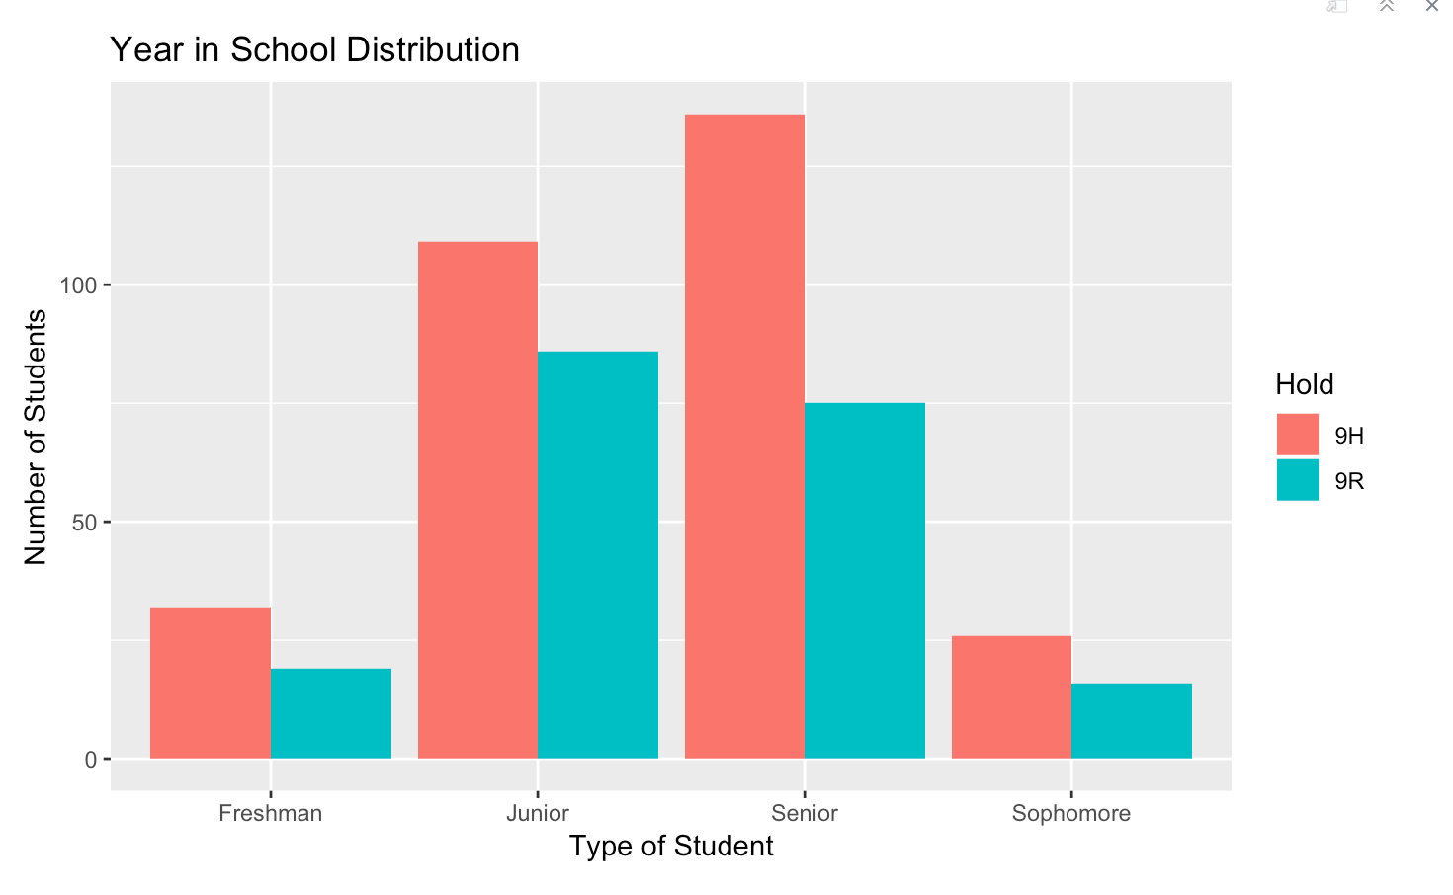
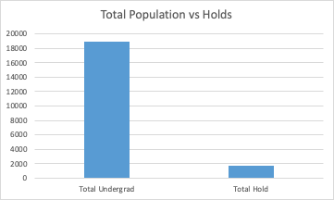
Financial Holds
1655 students had a hold
9% of total population
504 students cannot continue
due to financial hold.
Most are seniors (200 students)
Most have 9H hold (300 students)

Slide 15
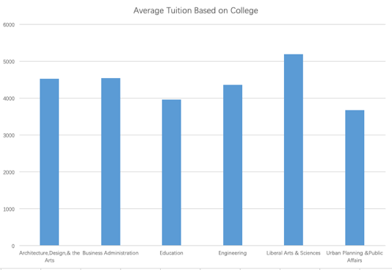
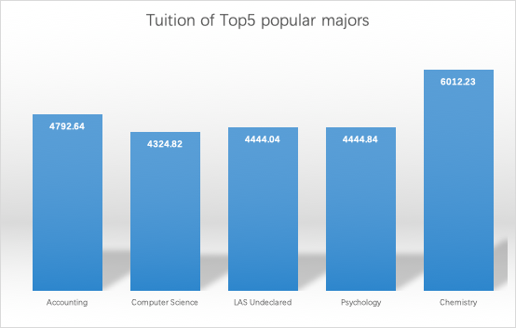
Avg Registration Fee: 578$
Avg Registration Tuition: 5640$
Cost of Attendance
Average Tuition by College
Chemistry, Accounting, Psychology, Computer Science, LAS Undeclared
Tuition of Top 5 Popular Majors
architecture
business
education
engineering
urban planning
LAS

Slide 16
SECTION III.
Future Directions
suggestions for next steps and new directions

Slide 17
Future Directions
DIRECTION 1
Improve predictive models. Make them more accurate.
DIRECTION 2
Connect statistical model with the real world situation to make it more practical
DIRECTION 3
Compare our findings to the actual situation

